Slide 1

What are Knowledge Graphs?

Slide 2
Outline
Knowledge Graph
Resurgence of interest in Knowledge Graphs
  Search engines
  Data integration
  Artificial Intelligence
What is new and different?

Slide 3
What is a Knowledge Graph?
B
A
C
Directed Labeled Graph

Slide 4
What is a Knowledge Graph?
Predicate
Subject
Object
Directed Labeled Graph

Slide 5
What is a Knowledge Graph?
knows
art
bob
Directed Labeled Graph

Slide 6
What is a Knowledge Graph?
Relation
Entity
Entity
Directed Labeled Graph

Slide 7
What is a Knowledge Graph?
subclass of
Class
Class
Directed Labeled Graph

Slide 8
What is a Knowledge Graph?
subclass of
Person
Human
Directed Labeled Graph

Slide 9
Outline
Graphs in Computer Science
Resurgence of interest in Knowledge Graphs
  Search engines
  Data integration
  Artificial Intelligence
What is new and different?

Slide 10
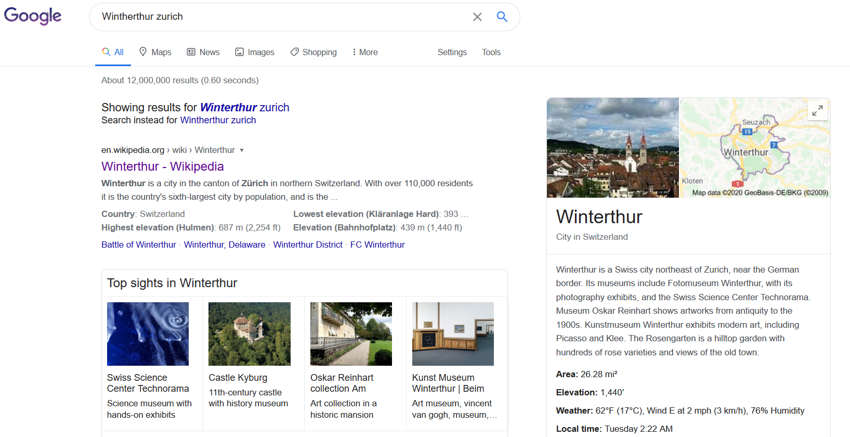
Knowledge Graphs in Web Search

Slide 11
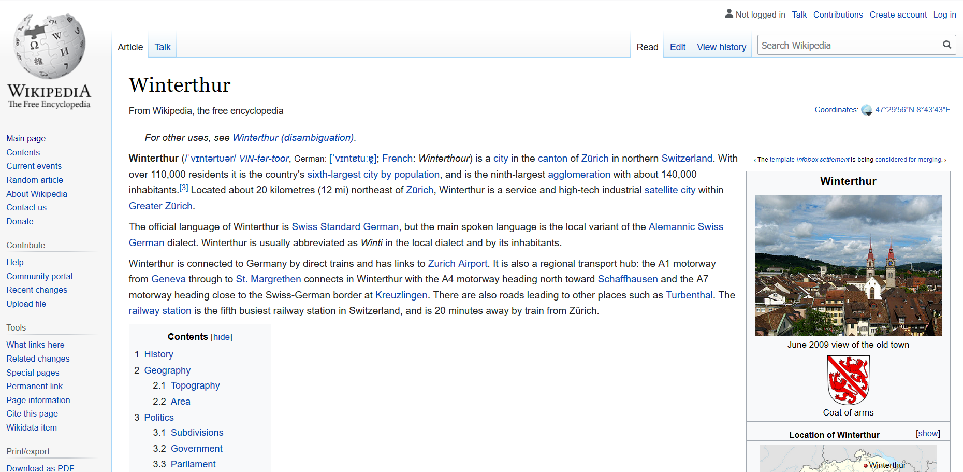

Slide 12
Knowledge Graphs in Web Search

Slide 13
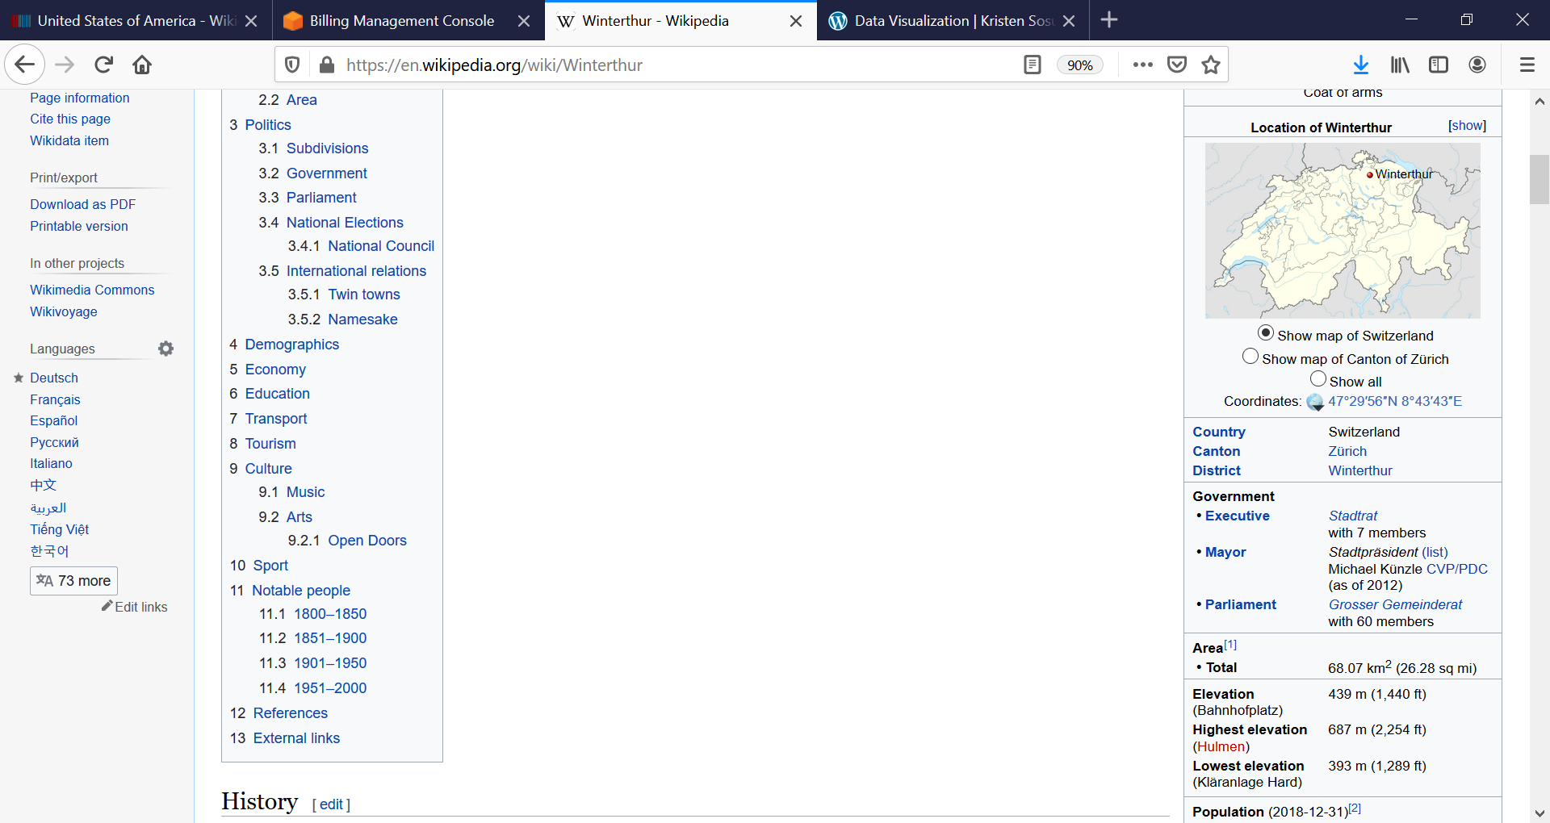
Knowledge Graphs in Web Search

Slide 14
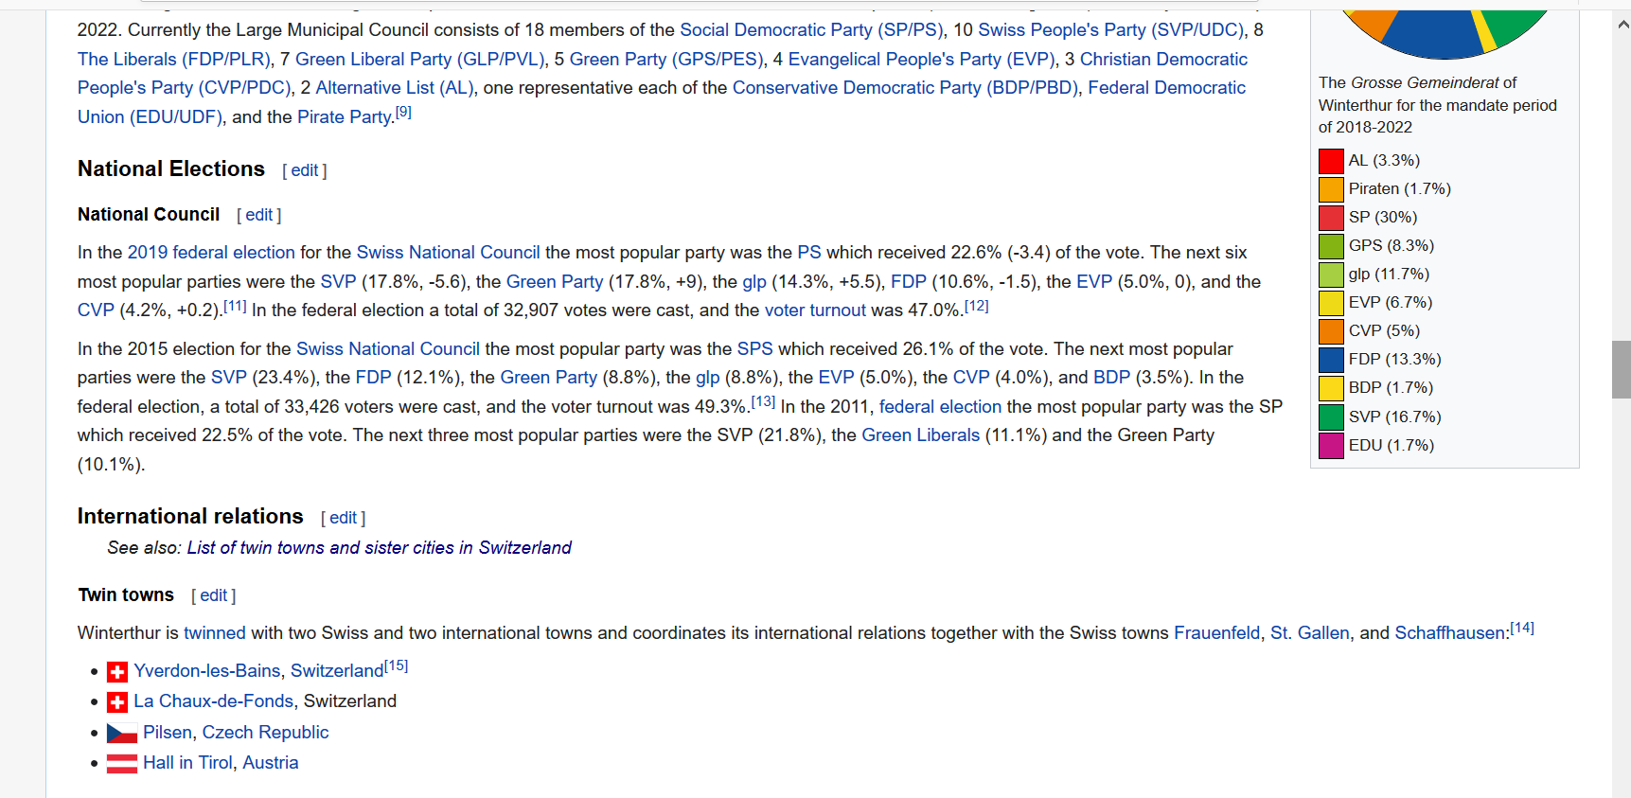

Slide 15
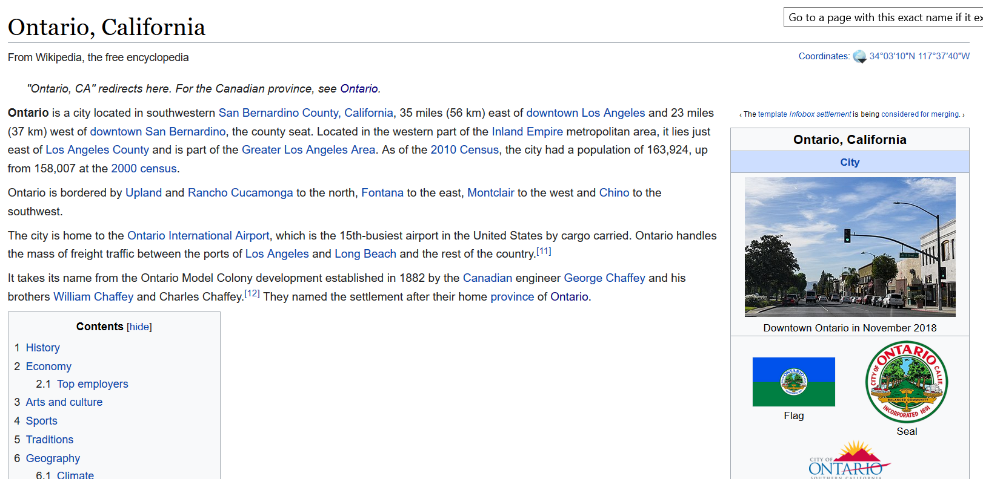

Slide 16
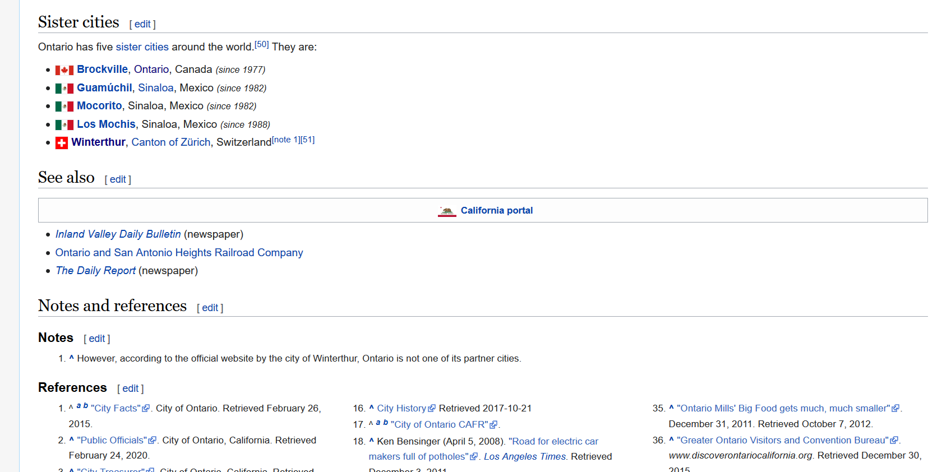

Slide 17
Problem
Twin Towns and Sister Cities are identical concepts
  The reference to Winterthur in the Ontario Page appears in text description
  There is no easy way to resolve the differences

Slide 18
Solution
Wikidata: Publicly curated Knowledge Graph

Slide 19
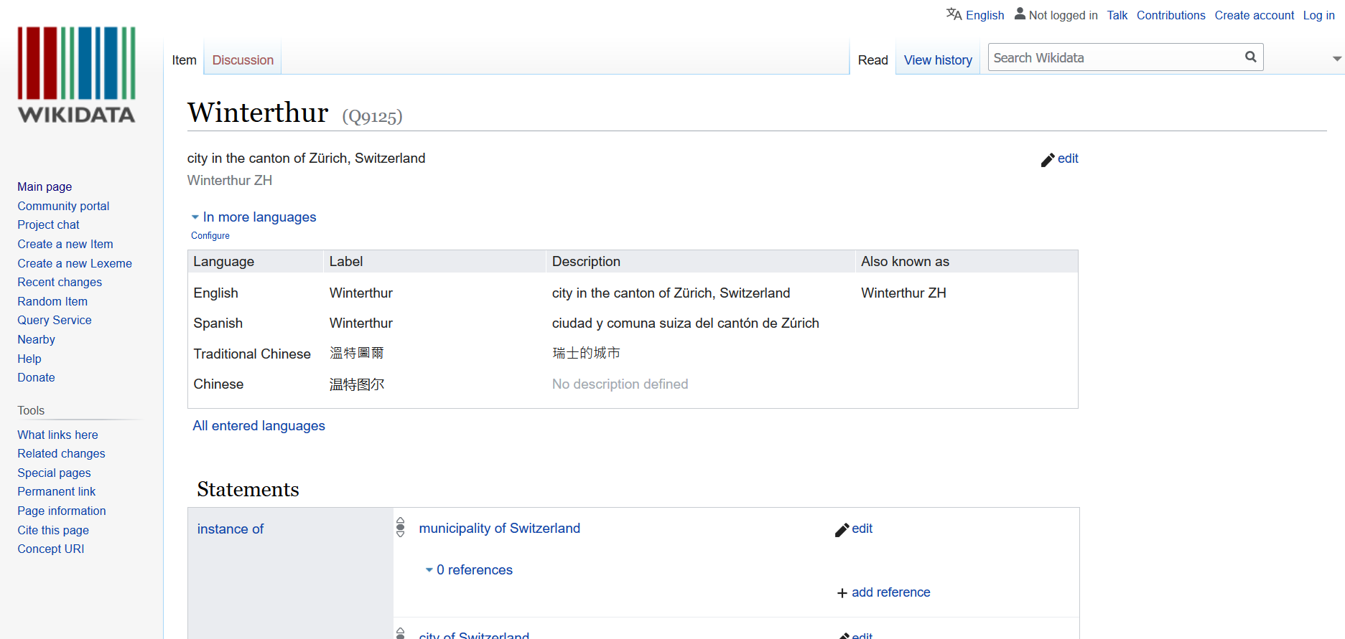

Slide 20
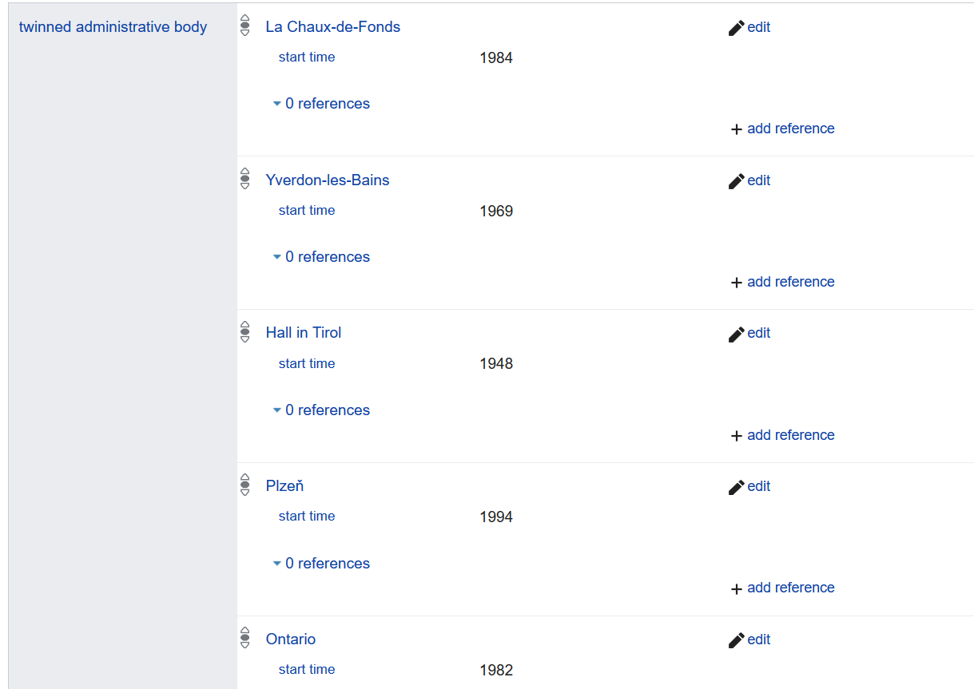

Slide 21
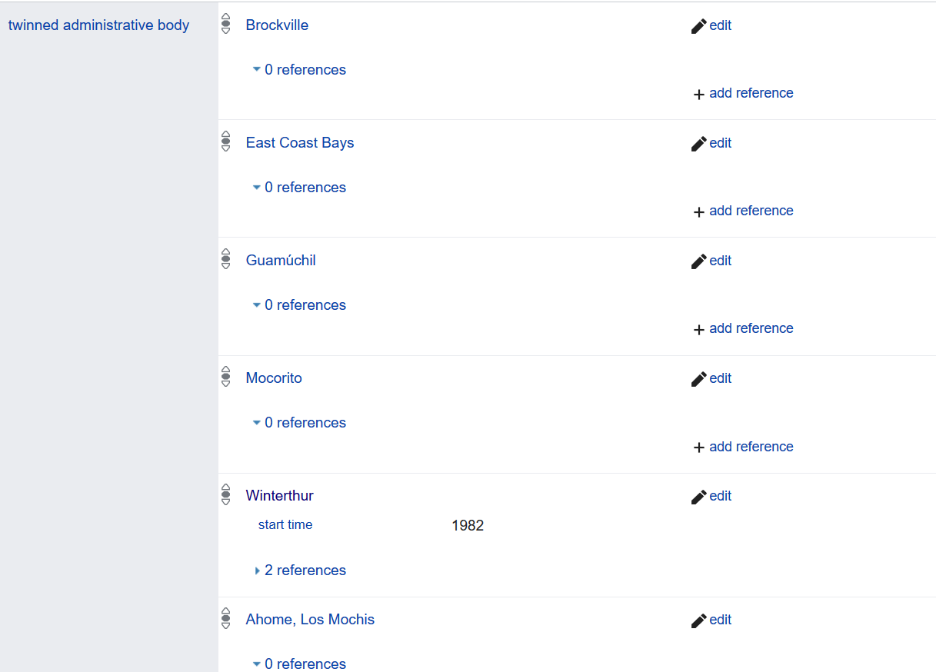

Slide 22
Graph Underlying Wikidata
Twinned administrative body
Winterthur
Ontario

Slide 23
Graph Underlying Wikidata
Twinned administrative body
Winterthur
Ontario
part of
country
Zurich Metropolitan Area
United States
part of
part of
Switzerland
North America

Slide 24
Graph Underlying Wikidata
Twinned administrative body
Winterthur
Ontario
same as
part of
country
Zurich Metropolitan Area
United States
Winterthur
part of
part of
Switzerland
North America
LIBRARY OF CONGRESS

Slide 25
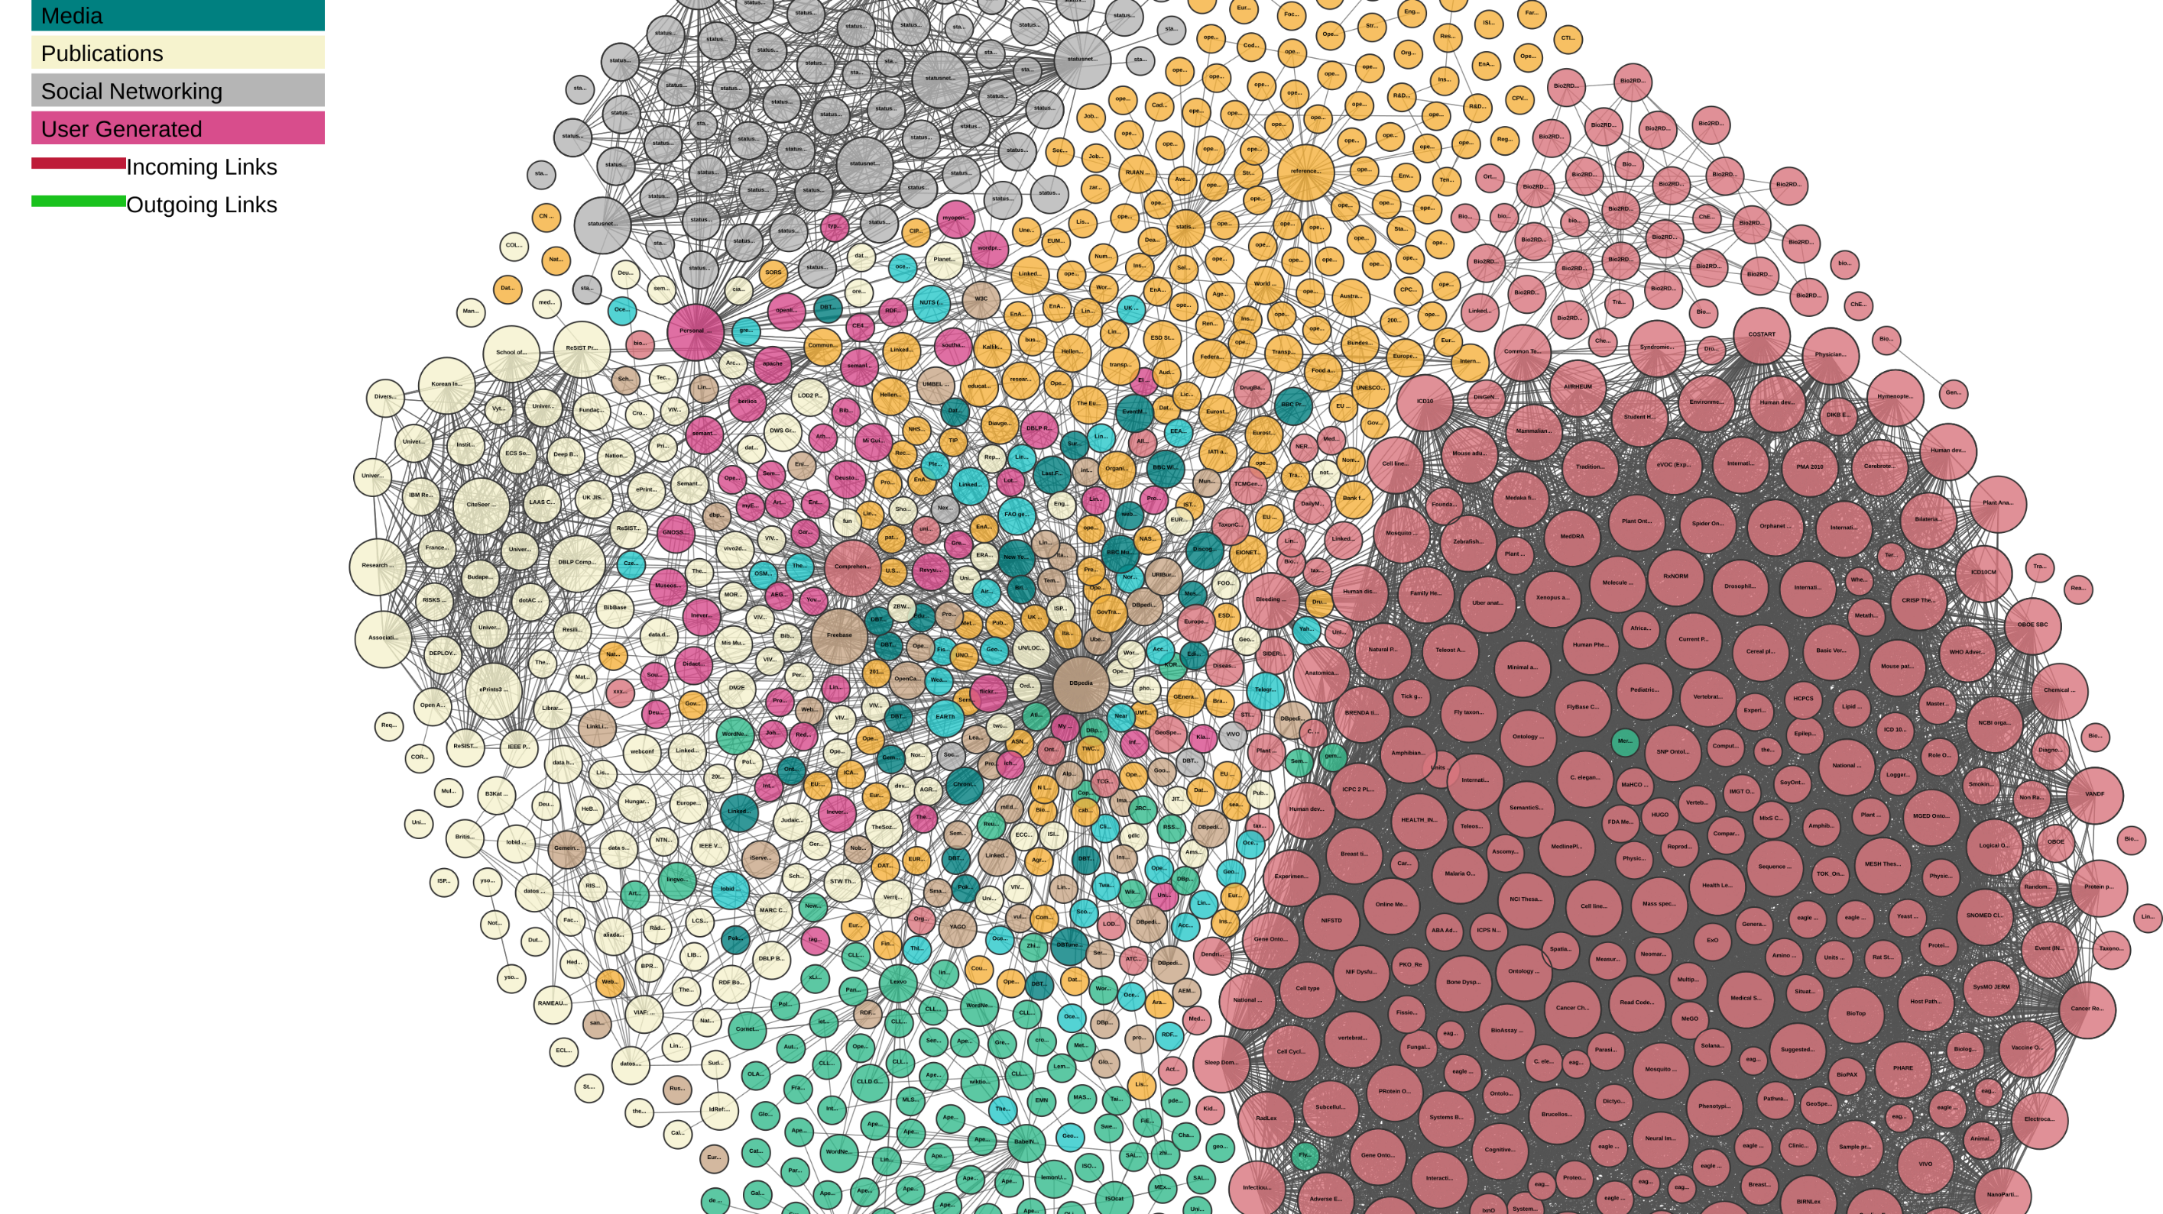

Slide 26
We can also query the data
Display on a map the birth cities of people who died in Winterthour?
Requires querying multiple data sources on the web
Requires understanding their schemas
  Schemas published using Schema.Org vocabulary
Structured results can then be included in the search results on the web pages

Slide 27
Scale of Wikidata
80+ Million Objects

Slide 28
Scale of Wikidata
1+ Billion Relationships

Slide 29
Scale of Wikidata
4872+ Catalogs

Slide 30
Wikidata Knowledge Graph
A graph of unprecedented scale
Collaboratively created
Data may be curated manually or automatically
Semantic definitions in Schema.Org
Compelling use case: Web Search

Slide 31
Outline
Graphs in Computer Science
Resurgence of interest in Knowledge Graphs
  Search engines
  Data integration
  Artificial Intelligence
What is new and different?

Slide 32
Data Integration
Data reside in multiple sources
  Company directory, product catalog, government database, weather report, …
Answering queries requires combining data from multiple sources
  We need to provide translations of data between multiple sources
    Direct mappings
    Shared schema

Slide 33
Data Integration
Schema-free approach to data integration
  Convert the relational data from multiple sources into triples
    Stored in a graph database
      Referred to as a knowledge graph
  Deal with schema mappings/translations on “pay as you go” basis
    Visualization
    Optimized for graph traversals

Slide 34


Example Use Case
360 Degree View of a Customer
Who is funding who?
Who supplies to who?
Who are my customers?
INTERNAL
COMPANY
DATA
Risk Analysis for Lending Decisions
Business Intelligence for Marketing

Slide 35
Outline
Graphs in Computer Science
Resurgence of interest in Knowledge Graphs
  Search engines
  Data integration
  Artificial Intelligence
What is new and different?

Slide 36
Artificial Intelligence
Output representation for
  Natural Language Processing
  Computer Vision
Input representation for machine learning
  Language Models
  Graph Models

Slide 37
Natural Language Processing
Albert Einstein was a German-born theoretical physicist who developed the theory of relativity.

Slide 38
Natural Language Processing
Entity Extraction
Albert Einstein was a German-born theoretical physicist who developed the theory of relativity.

Slide 39
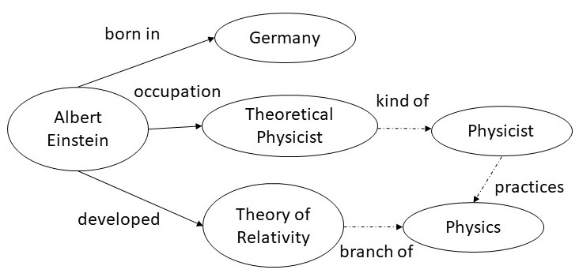
Natural Language Processing
Entity Extraction
Albert Einstein was a German-born theoretical physicist who developed the theory of relativity.
Relation Extraction

Slide 40
Natural Language Processing
Entity Extraction
Albert Einstein was a German-born theoretical physicist who developed the theory of relativity.
Relation Extraction
Question Answering
Common Sense Reasoning

Slide 41
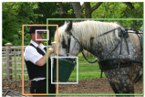
Computer Vision

Slide 42
Computer Vision
Object Detection

Slide 43
Computer Vision
Object Detection
Edge Detection
wearing
glasses
feeding
Man
horse
eating from
holding
bucket

Slide 44
Computer Vision
Object Detection
Edge Detection
wearing
glasses
feeding
Man
horse
eating from
holding
bucket
Visual Question Answering

Slide 45
Input to Machine Learning
Machine learning requires numerical input
  Symbolic inputs must be converted to numerical input
    A process known as embedding
      Word Embeddings
      Graph Embeddings

Slide 46
Word Embedding
Primary use case is to calculate similarity between words
  “like” is similar to “enjoy”
But, generally useful for a variety of language understanding tasks
Key idea: capture the meaning or a word by counting how often it occurs next to other words

Slide 47
Word Embedding
I like knowledge graphs.
I like databases.
I enjoy running.

Slide 48
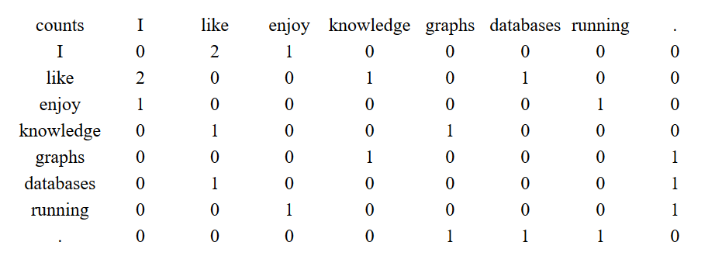
Word Embedding
I like knowledge graphs.
I like databases.
I enjoy running.

Slide 49
Word Embedding
Meaning of a word is captured by the vector corresponding to each row of co-occurrence counts
Word similarity can be calculated using the distance between the vectors

Slide 50
Word Embedding
A large scale text corpus can have billion plus words
  The storage requirement for the vectors blows up
    Dimensionality reduction (typically in the range of 200)
    Linear algebra techniques (e.g., Singular Value Decomposition)
    Automatic learning of the necessary parameters

Slide 51
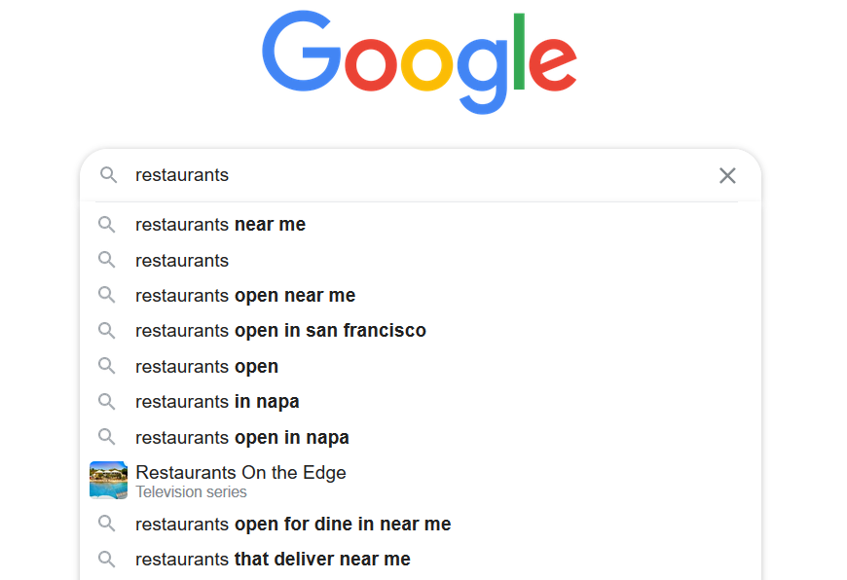
Word Embedding
A popular application is to predict the next word

Slide 52
Word Embedding
Word embeddings view the text as a linear graph
  Word prediction is the instance of more general problem of link prediction
I
like
knowledge
graphs
.

Slide 53
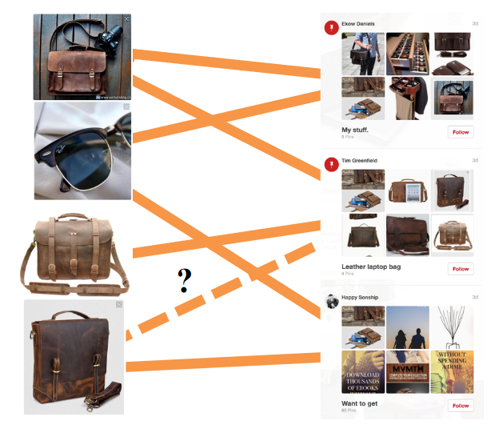
Graph Embedding
Generalize what we did for word embeddings
  Goal is still to reduce the nodes to vectors so that we can calculate the node similarity as a difference between the vectors
Application areas
  Recommendation engines

Slide 54
Graph Embedding
Graph embedding requires a function to
  encode each node into a vector
  calculate node similarity
  optimize the encoding function
Example encoding function
  Randomly walk the graph
  Compute the cooccurrence counts between the nodes

Slide 55
Summary
Graphs are a fundamental construct in discrete mathematics
Rich history of usage of graphs in data and knowledge modeling
Recent surge of interest driven by
  Data linking and sharing over the web
  Graph computations over data
  Progress in NLP and vision to extract relations
Knowledge graphs are an instance of more general graphs
Tremendous opportunity to leverage classical knowledge representation

Slide 56
What are Knowledge Graph Data Models?
Coming up Next …..

