Slide 1

What are some High Value Use Cases of Knowledge Graphs?

Slide 2
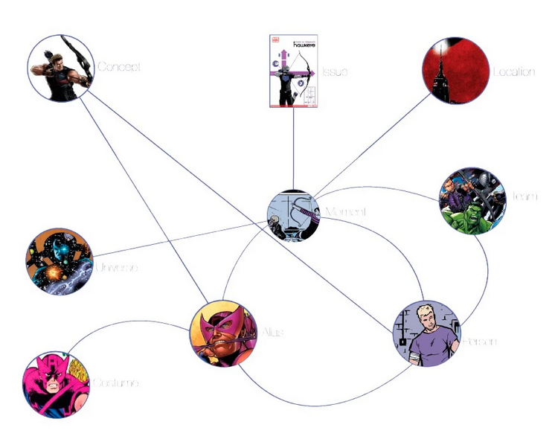
Applications of Knowledge Graphs
Entertainment: Knowledge Graph of Marvel’s Cinematic Universe

Slide 3

Applications of Knowledge Graphs
Investigative Journalism

Slide 4
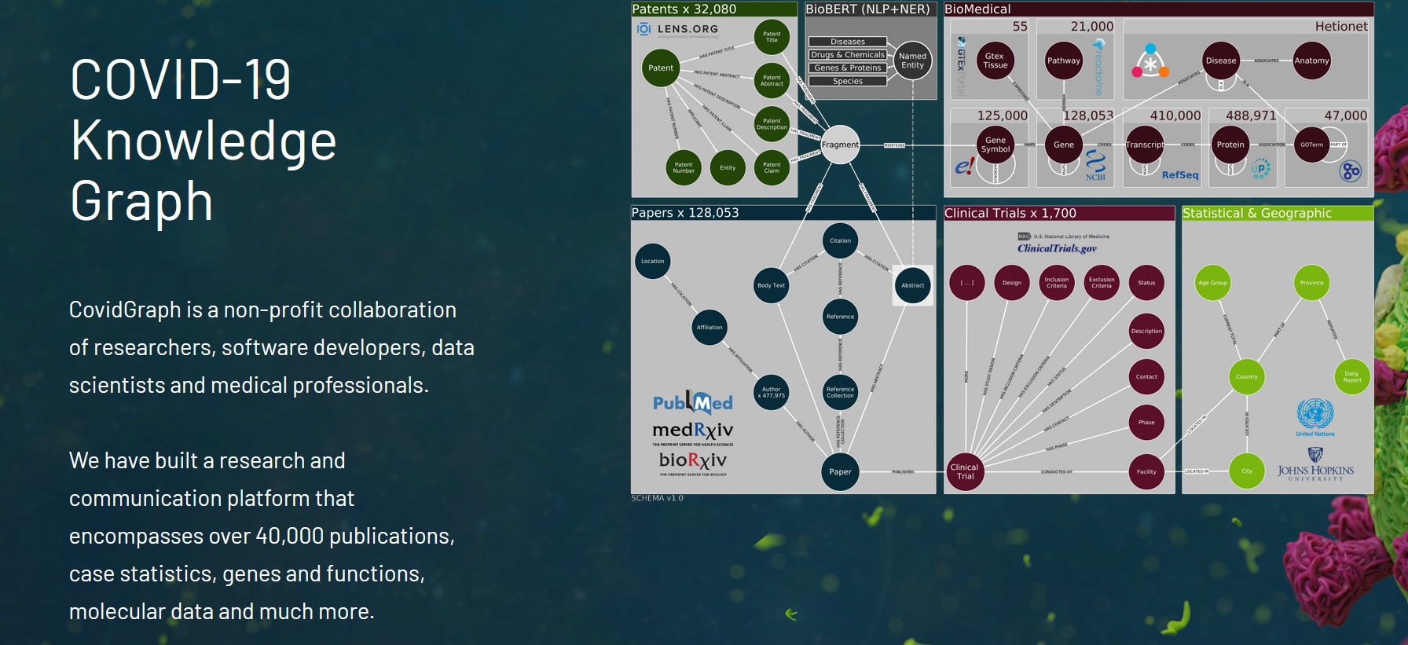
Applications of Knowledge Graphs
Biomedicine

Slide 5
Outline
Knowledge Graphs in Finance
  Financial Analytics
  Financial Calculations
  Financial Reporting

Slide 6
Knowledge Graphs for Financial Analytics
Example business questions
  Which of our clients are suppliers of company X that is in financial trouble?
  In a supply chain network, is there a single company that connects a group of companies?
  Which startups have attracted most influential investors?
  Which group of investors tend to coinvest?
  Which companies are most similar to a given company?
  Which company might be a good future client for us?

Slide 7

Knowledge Graphs for Financial Analytics
Which of our clients are suppliers of company X that is in financial trouble?
Who supplies to who?
Who are my customers?
INTERNAL
COMPANY
DATA

Slide 8
Knowledge Graphs for Financial Analytics
Which of our clients are suppliers of company X that is in financial trouble?
  Answered using path finding
Who supplies to who?
Who are my customers?
INTERNAL
COMPANY
DATA
B
A
C
D
E

Slide 9
Knowledge Graphs for Financial Analytics
In a supply chain network, is there a single company that connects a group of companies?
Who supplies to who?
Who are my customers?
INTERNAL
COMPANY
DATA

Slide 10
Knowledge Graphs for Financial Analytics
In a supply chain network, is there a single company that connects a group of companies?
  Answered using between-ness centrality
Who supplies to who?
Who are my customers?
A
INTERNAL
COMPANY
DATA
B

Slide 11

Knowledge Graphs for Financial Analytics
Which startups have attracted most influential investors?
Who are my customers?
Who is funding who?
INTERNAL
COMPANY
DATA

Slide 12
Knowledge Graphs for Financial Analytics
Which startups have attracted most influential investors?
  Answered using page rank
Who are my customers?
Who is funding who?
INTERNAL
COMPANY
DATA

Slide 13
Knowledge Graphs for Financial Analytics
Which group of investors tend to coinvest?
Who are my customers?
Who is funding who?
INTERNAL
COMPANY
DATA

Slide 14
Knowledge Graphs for Financial Analytics
Which group of investors tend to coinvest?
  Answered using community detection algorithms
Who are my customers?
Who is funding who?
A
INTERNAL
COMPANY
DATA
B

Slide 15
Knowledge Graphs for Financial Analytics
Example business questions
  Which companies are most like a given company?
    Use graph embeddings to calculate similarity
  Which company might be a good future client for us?
    Use link prediction to identify future customers

Slide 16
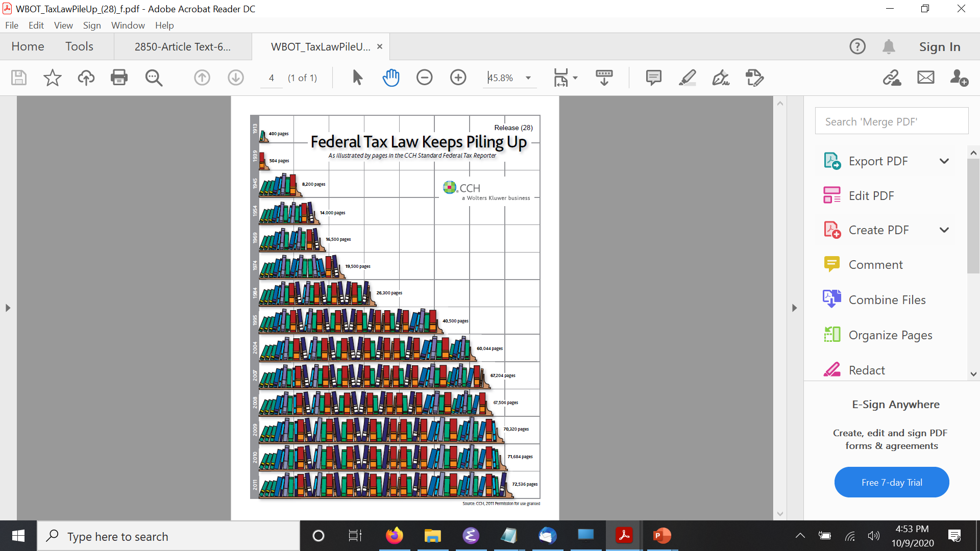
Knowledge Graphs for Financial Calculations
Federal Tax Law
  72,000 pages
  1000s forms
  Changing every year

Slide 17
Knowledge Graphs for Financial Calculations
Model the tax law using a set of rules
Leverage the graph structure in the rules to
  Generate user interviews/dialogs
  Apply the rules for tax calculations

Slide 18
Knowledge Graphs for Financial Calculations
A person is qualified for a tax benefit if:
    the person is a resident of California, and
    the age of the person is greater than 18 years

Slide 19
Knowledge Graphs for Financial Calculations
A person is qualified for a tax benefit if:
    the person is a resident of California, and
    the age of the person is greater than 18 years
qualified_for_tax_benefit(P) :- resident_of(P,CA) & age(P,N) & min(N,18,18)

Slide 20
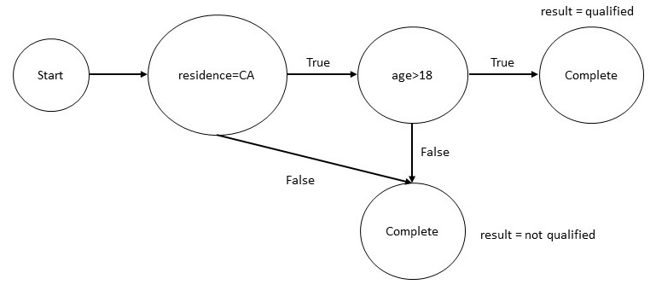
Knowledge Graphs for Financial Calculations
A person is qualified for a tax benefit if:
    the person is a resident of California, and
    the age of the person is greater than 18 years
qualified_for_tax_benefit(P) :- resident_of(P,CA) & age(P,N) & min(N,18,18)

Slide 21
Knowledge Graphs for Financial Calculations
Intuit has developed a tax knowledge engine to capture tax law
The graph structure of the rules drives TurboTax® line of products

Slide 22
Knowledge Graphs for Financial Reporting
Financial Reporting Requirements
  Derivative contracts
    Interest rate and commodity swaps
    Options
    Futures
    Forwards
    Asset back securities

Slide 23
Knowledge Graphs for Financial Reporting
Financial Reporting Requirements
  Consumer of the reports
    Internal compliance teams
    Brokers and dealers
    Regulators

Slide 24
Knowledge Graphs for Financial Reporting
Financial Reporting Requirements
  Standardize the reports using FIBO
    FIBO – Financial Industry Business Ontology
      Defined in Web Ontology Language
      Developed by multiple stakeholders
      Provide semantics to the data in the reports

Slide 25
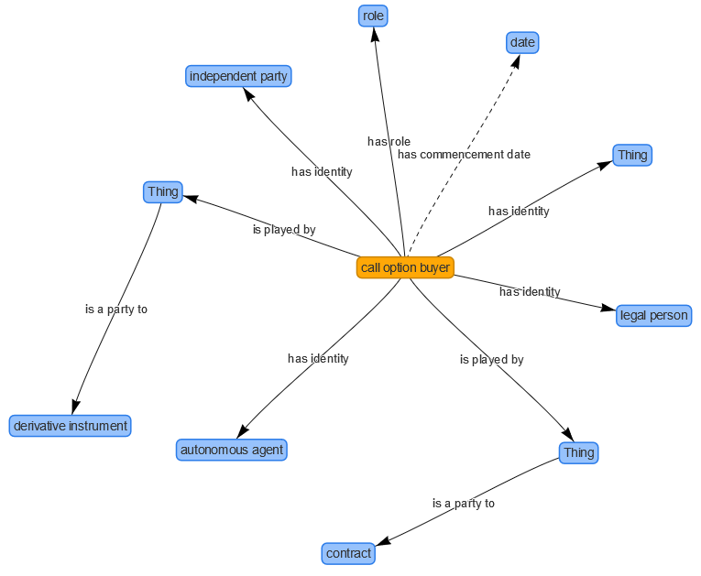
Knowledge Graphs for Financial Reporting
Financial Reporting Requirements
  Standardize the reports using FIBO

Slide 26
Knowledge Graphs for Financial Reporting
Financial Reporting Requirements
  Standardize the reports using FIBO
    FIBO has many other use cases
      Counter party exposure
      Index analysis for ETF Development
      Exchange instrument data offering

Slide 27
Summary
Knowledge Graphs in Finance
  Financial Analytics
  Financial Calculations
  Financial Reporting

